Slide 1
Kubernetes Services
By Chetan Shah

Slide 2
Services

Slide 3
Kubernetes - Deployments vs Services
A deployment is responsible for keeping a set of pods running.
A service is responsible for enabling network access to a set of pods.
We could use a deployment without a service to keep a set of identical pods running in the Kubernetes cluster. The deployment could be scaled up and down and pods could be replicated. Each pod could be accessed individually via direct network requests (rather than abstracting them behind a service), but keeping track of this for a lot of pods is difficult.

Slide 4
Services
Services is an abstraction over a group of Pods
Pods serving the same functionality can be grouped together to form a service
Each Pod has an IP address, hence if one has to manage the same application on multiple Pods, it will be a difficult situation.
Services abstract that, and provide a single IP address over all those Pods.
The Service also load balances the calls across the Pods providing that Service.

Slide 5
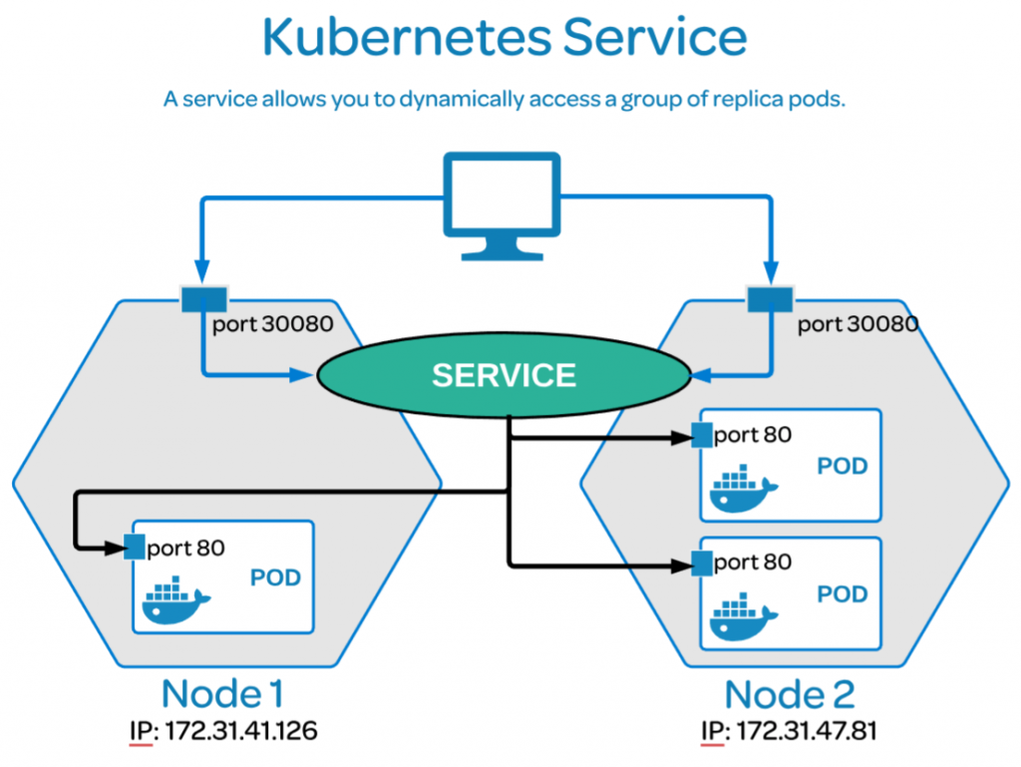
Services

Slide 6
Types of Services
ClusterIP. Exposes a service which is only accessible from within the cluster.
NodePort. Exposes a service via a static port on each node’s IP.
LoadBalancer. Exposes the service via the cloud provider’s load balancer.
ExternalName. Maps a service to a predefined externalName field by returning a value for the CNAME record.

Slide 7
Kubernetes ClusterIP service
ClusterIP is the default type of service, which is used to expose a service on an IP address internal to the cluster. Access is only permitted from within the cluster.

Slide 8
Kubernetes ClusterIP service YAML
apiVersion: v1
kind: Service
metadata:
name: my-service
spec:
selector:
app: MyApp
ports:
- protocol: TCP
port: 80
targetPort: 9376

Slide 9
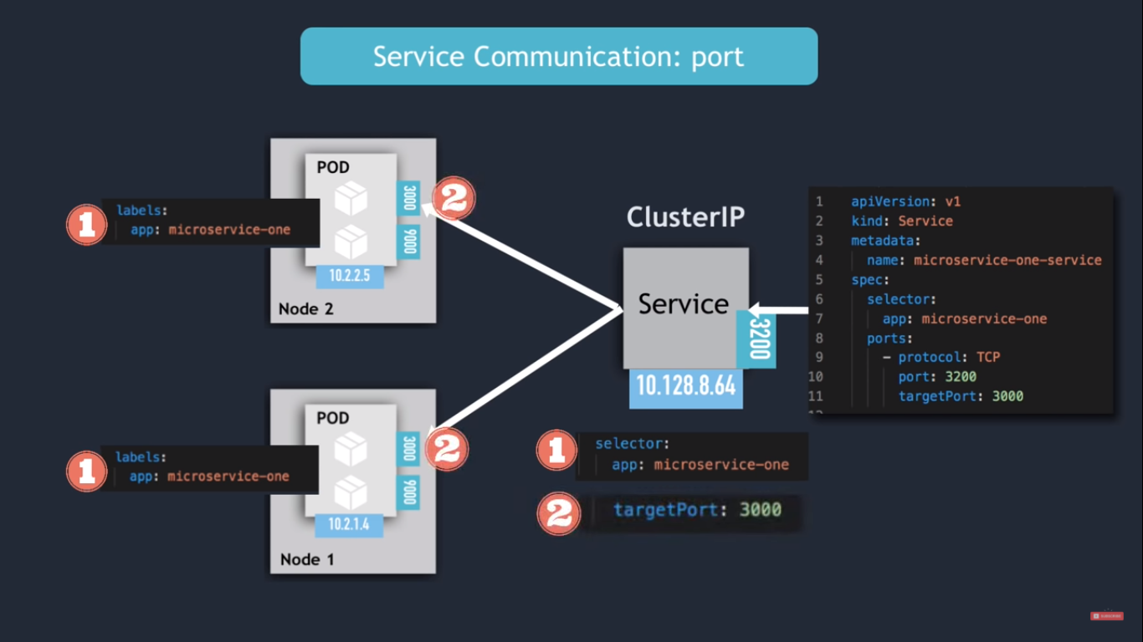
Kubernetes ClusterIP service

Slide 10
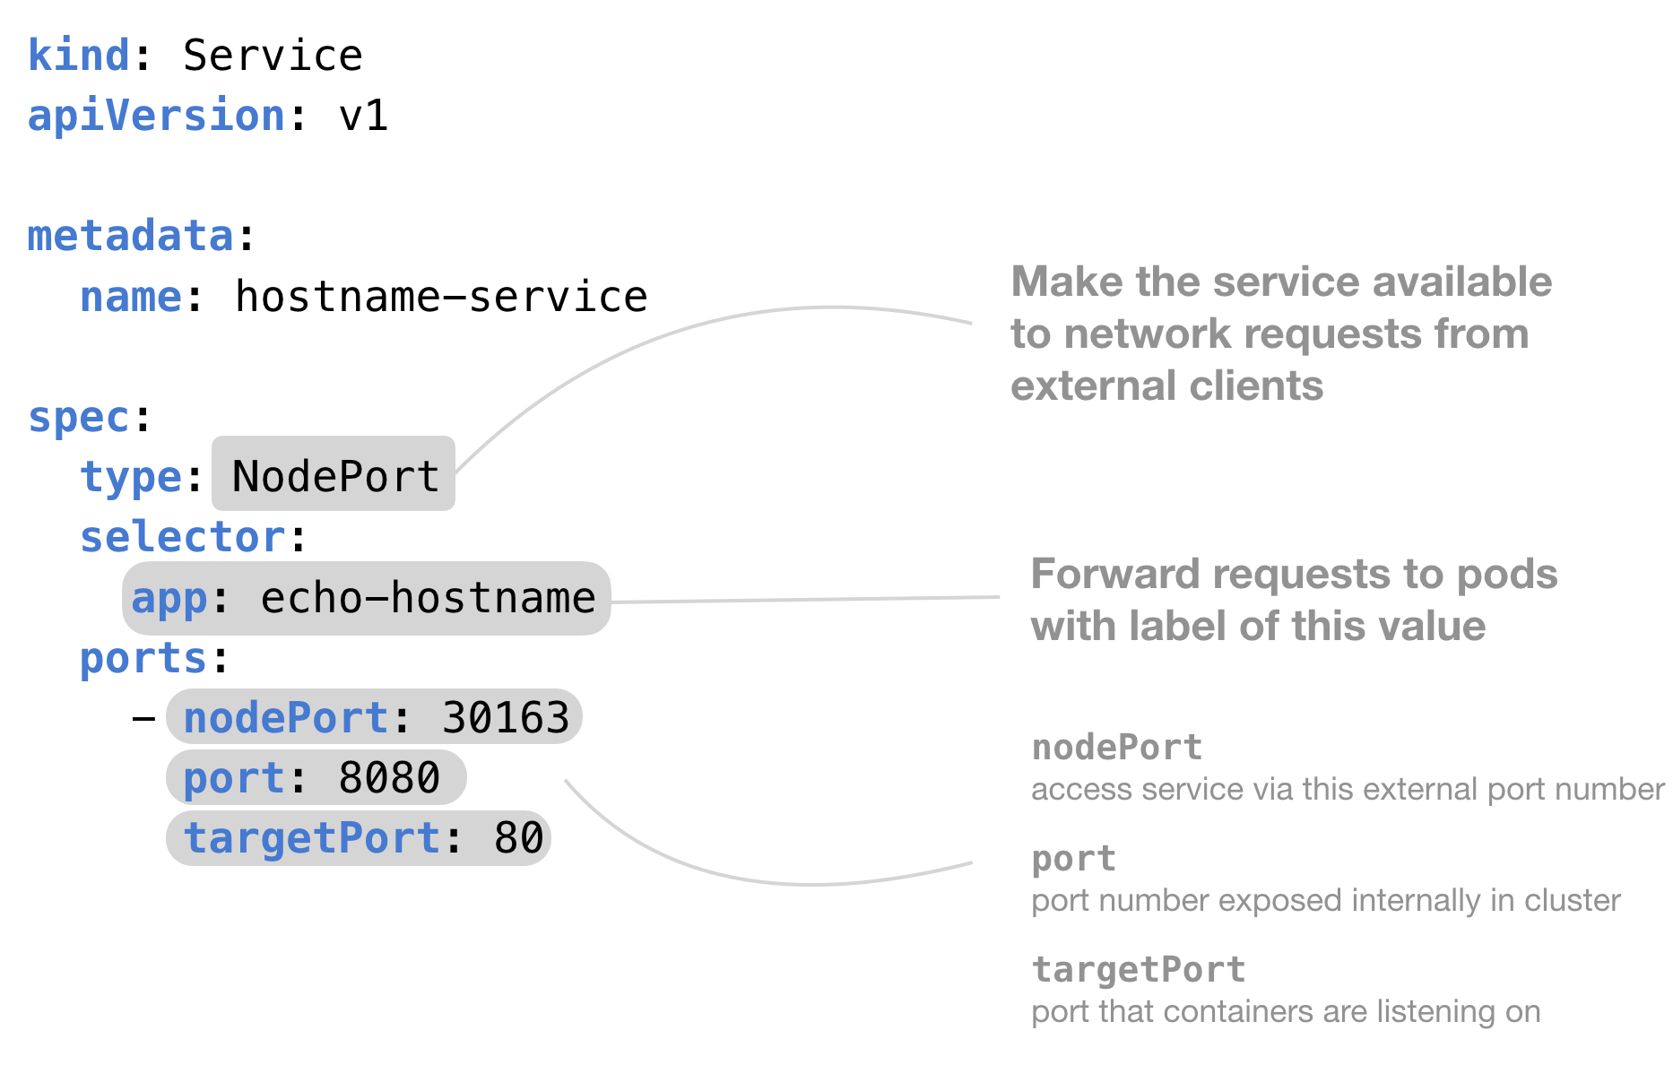
Kubernetes NodePort service

Slide 11
Kubernetes NodePort service
kind: Service
apiVersion: v1
metadata:
name: hostname-service
spec:
# Expose the service on a static port on each node
# so that we can access the service from outside the cluster
type: NodePort
# When the node receives a request on the static port (30163)
# "select pods with the label 'app' set to 'echo-hostname'"
# and forward the request to one of them
selector:
app: echo-hostname
ports:
# Three types of ports for a service
# nodePort - a static port assigned on each the node
# port - port exposed internally in the cluster
# targetPort - the container port to send requests to
- nodePort: 30163
port: 8080
targetPort: 80

Slide 12
Kubernetes - Why different Service Types
ClusterIP – Default - The service is only accessible from within the Kubernetes cluster – you cannot make requests to your Pods from outside the cluster!
NodePort – Service is accessible on a static port on each Node in the cluster making it making it accessible from outside the cluster.
LoadBalancer – The service becomes accessible externally through a cloud provider's load balancer functionality. GCP, AWS, Azure, and OpenStack offer this functionality. The cloud provider will create a load balancer, which then automatically routes requests to your Kubernetes Service

Slide 13
Kubernetes - Endpoints Object
We have learned about Kubernetes Services that we could use labels to match a frontend service with a backend pod automatically by using a selector.
If any new pods had a specific label, the service knows how to send traffic to it.
How?
The service knows to do this is by adding this mapping to an endpoint.
Endpoints track the IP Addresses of the objects the service send traffic to.
When a service selector matches a pod label, that IP Address is added to your endpoints.

Slide 14
Kubernetes - Endpoints Object
apiVersion: apps/v1
kind: Deployment
metadata:
name: training-deployment
spec:
selector:
matchLabels:
app: training
version: v1
replicas: 3
template:
metadata:
labels:
app: training
version: v1
spec:
containers:
- name: training-container
image: training:1.0
ports:
- containerPort: 80
---
apiVersion: v1
kind: Service
apiVersion: v1
metadata:
name: training-service
spec:
selector:
app: training
type: ClusterIP
ports:
- name: training-port
port: 8080
targetPort: 80
#kubectl create -f deployment.yaml

Slide 15
Kubernetes - Service sans Selector
apiVersion: apps/v1
kind: Deployment
metadata:
name: training-deployment
spec:
selector:
matchLabels:
app: training
version: v1
replicas: 3
template:
metadata:
labels:
app: training
version: v1
spec:
containers:
- name: training-container
image: training:1.0
ports:
- containerPort: 80
---
apiVersion: v1
kind: Service
apiVersion: v1
metadata:
name: training-service
spec:
type: ClusterIP
ports:
- name: training-port
port: 8080
targetPort: 80
#kubectl create -f deploymentXXX.yaml

Slide 16
Kubernetes - Create the Endpoint Object
Get the pod ip address by: kubectl get pods -o wide
apiVersion: v1
kind: Endpoints
metadata:
name: training-service
subsets:
- addresses:
- ip: 10.1.0.60
- ip: 10.1.0.61
- ip: 10.1.0.62
- ip: 10.1.0.63
ports:
- port: 80
kubectl get endpoints

Slide 17
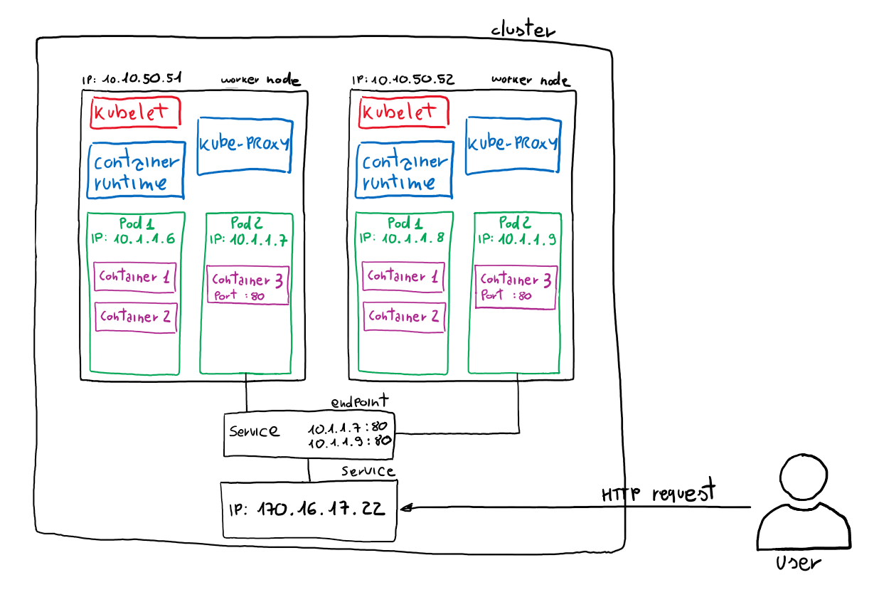
Kubernetes -
Endpoints
Object

Slide 18
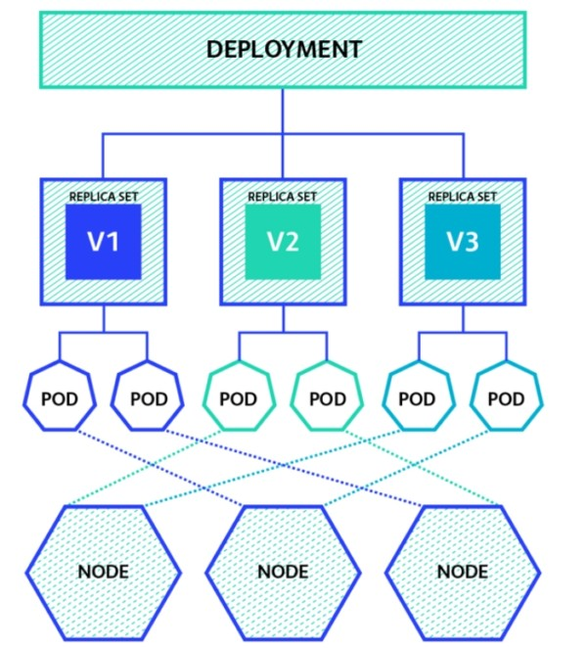
Kubernetes -
Deployment -
relook

Slide 19
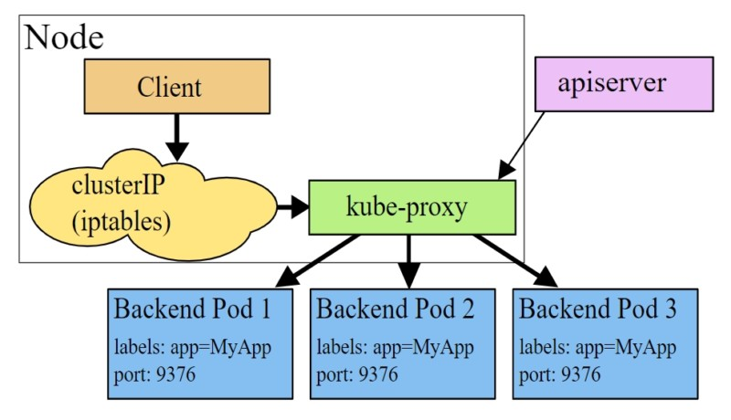
Kubernetes - Services - relook

Slide 20
Useful Kubectl Commands
kubectl get pod # get all the pods
kubectl got pod -o wide #get all the pods with a wider output

Slide 21
Services - Handson Session

Slide 22
Nodeport Service
Deployment
Create a deployment with this yaml. Call it nginxdep.yaml.
Apply the deployment:
Kubectl apply -f nginxdep.yaml
Get the pods:
Kubectl get pods -o wide
SSH into one pd:
kubectl exec <podId> -it sh
Install curl:
apk add curl
Curl the other Pod:
Curl <other pods IP>
If you see the nginx default page HTML as output, the pods are able to see and communicate with one another.
Same can be tried from the other Pod.
Though the nginx is still not available outside.
For that we create service.
apiVersion: apps/v1
kind: Deployment
metadata:
name: my-nginx-deploy
labels:
app: nginx
spec:
replicas: 2
selector:
matchLabels:
app: nginx
template:
metadata:
labels:
app: nginx
spec:
containers:
- name: test-nginx
image: nginx:alpine
ports:
- containerPort: 80

Slide 23
Nodeport Service
Service
Create a service with this yaml. Call it nginxsvc.yaml.
Apply the deployment:
kubectl apply -f nginxsvc.yaml
Get the svc:
kubectl get svc
The service is available at the Cluster IP shown above.
The service needs to be tunneled to be available outside the cluster.
Tunnel the service:
minikube service <service> --url
The output shows a table with the service name and the URL at which it is available on the host machine.
Copy that URL and put it in the browser to see the nginx welcome page.
apiVersion: v1
kind: Service
metadata:
name: my-service
spec:
type: NodePort
selector:
app: nginx
ports:
# By default the `targetPort` is set to the same value as the `port` field.
- port: 80
targetPort: 80
# Optional field
# By default and for convenience, the Kubernetes control plane will allocate a port from a range (default: 30000-32767)
nodePort: 30007

Slide 24
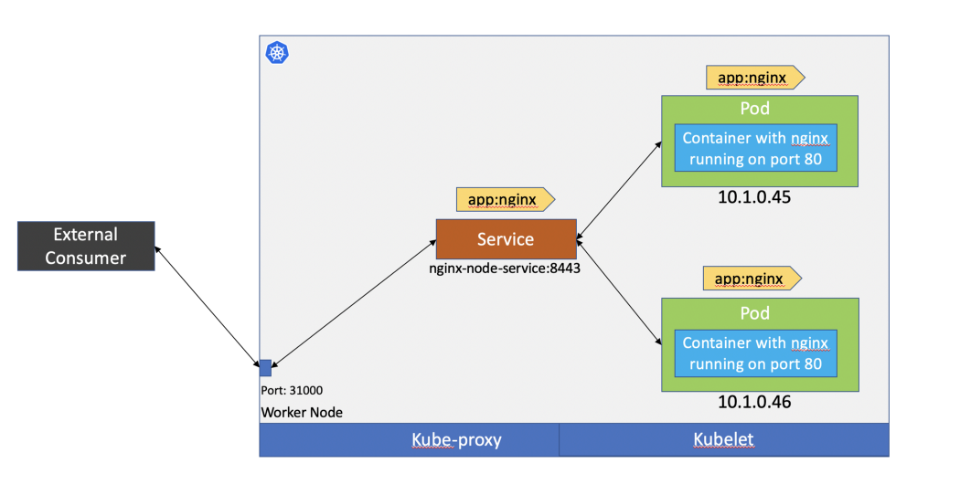
NodePort Service

Slide 25
LoadBalancer Service
Service
Create a service with this yaml. Call it nginxlbsvc.yaml.
Apply the deployment:
kubectl apply -f nginxlbsvc.yaml
Get the svc:
kubectl get svc
The service needs to be tunneled to be available outside the cluster.
Tunnel the service:
minikube service <service> --url
The output shows a table with the service name and the URL at which it is available on the host machine.
Copy that URL and put it in the browser to see the nginx welcome page.
apiVersion: v1
kind: Service
metadata:
name: nginx-load-service
spec:
type: LoadBalancer
selector:
app: nginx
ports:
- name: "80"
port: 80
targetPort: 80

Slide 26
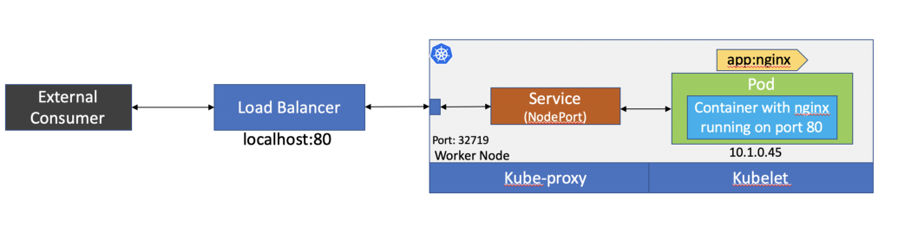
Load Balancer Service

Slide 27
NodePort Vs LoadBalancer Service
In NodePort service the service is available at a static port on the Node.
Moreover, if the Node restarts, the IP address of that Node will change. Hence the URL of the Service will have to be changed for external access. A major drawback.
Both these are overcome in the LoadBalancer type of service.
The port range for Nodeport service by default is from 30000 to 32767. It can be increased to a custom port range.

